Slide 1
DC TRANSIENT ANALYSIS
CHAPTER 5

Slide 2
SUB - TOPICS
NATURAL RESPONSE OF RL CIRCUIT
NATURAL RESPONSE OF RC CIRCUIT
STEP RESPONSE OF RL CIRCUIT
STEP RESPONSE OF RC CIRCUIT

Slide 3
OBJECTIVES
To investigate the behavior of currents and voltages when energy is either released or acquired by inductors and capacitors when there is an abrupt change in dc current or voltage source.
To do an analysis of natural response and step response of RL and RC circuit.

Slide 4
FIRST – ORDER CIRCUITS
A circuit that contains only sources, resistor and inductor is called and RL circuit.
A circuit that contains only sources, resistor and capacitor is called an RC circuit.
RL and RC circuits are called first – order circuits because their voltages and currents are describe by first order differential equations.

Slide 5
R
R
i
i
V_{s}
L
v_{s}
–
+
C
–
+
An RL circuit
An RC circuit

Slide 6
Review (conceptual)
Any first – order circuit can be reduced to a Thévenin (or Norton) equivalent connected to either a single equivalent inductor or capacitor.
In steady state, an inductor behave like a short circuit.
In steady state, a capacitor behaves like an open circuit.
R_{Th}
I_{N}
R_{N}
L
V_{Th}
–
+
C

Slide 7
The natural response of an RL and RC circuit is its behavior (i.e., current and voltage ) when stored energy in the inductor or capacitor is released to the resistive part of the network (containing no independent sources)
The steps response of an RL and RC circuits is its behavior when a voltage or current source step is applied to the circuit, or immediately after a switch state is changed.

Slide 8
NATURAL RESPONSE OF AN RL CIRCUIT
Consider the following circuit, for which the switch is closed for t<0, and then opened at t = 0:
The dc voltage V, has been supplying the RL circuit with constant current for a long time
t = 0
i
+
V
–
I_{s}
R_{o}
L
R

Slide 9


Solving for the circuit
For t ≤ 0, i(t) = Io
For t ≥ 0, the circuit reduce to
Notation:
is used to denote the time just prior to switching.
is used to denote the time immediately after switching.
i
+
v
–
I_{o}
R_{o}
L
R

Slide 10
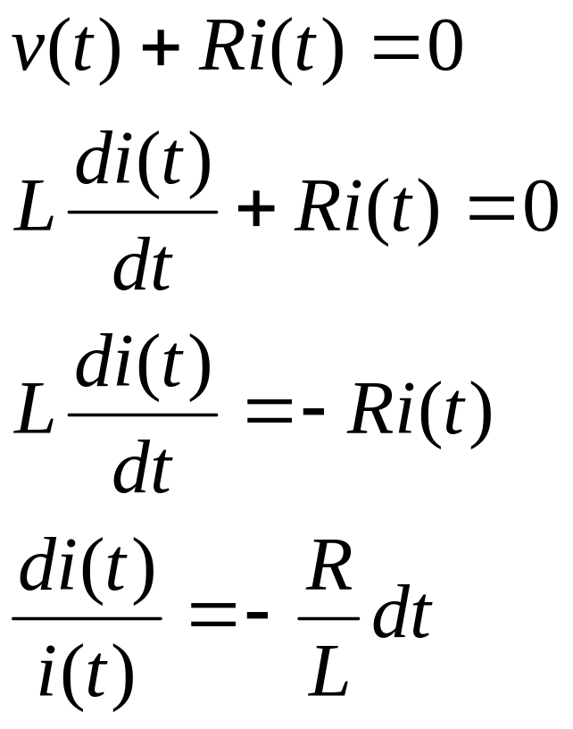
Continue…
Applying KVL to the circuit:
(1)
(2)
(3)
(4)

Slide 11
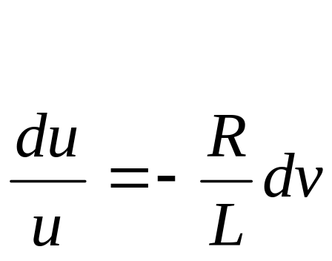
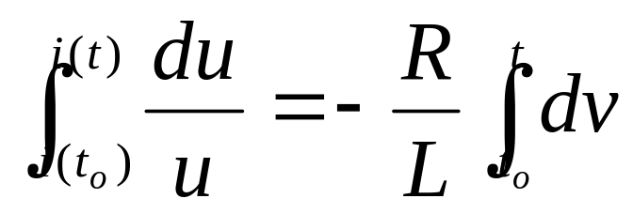
Continue
From equation (4), let say;
Integrate both sides of equation (5);
Where:
i(to) is the current corresponding to time to
i(t) ia the current corresponding to time t
(5)
(6)

Slide 12
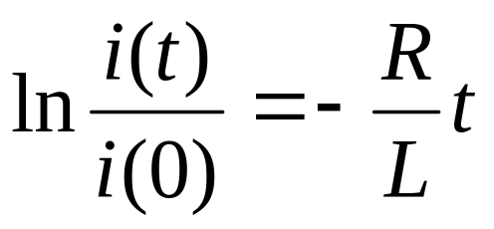
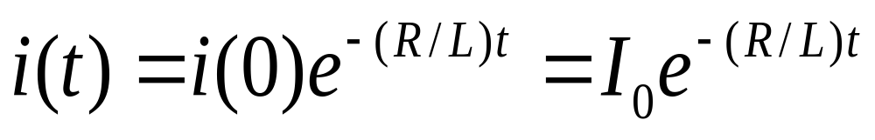
Continue
Therefore,
hence, the current is
(7)

Slide 13
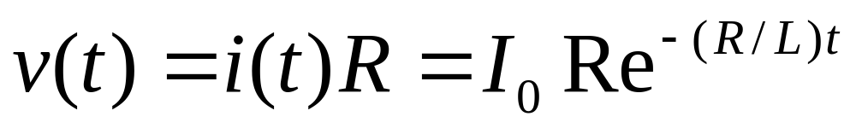
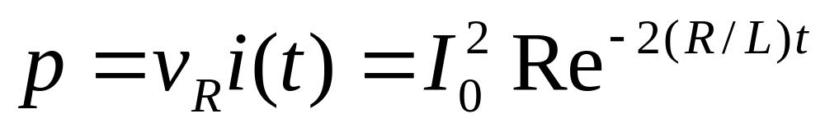
Continue
From the Ohm’s law, the voltage across the resistor R is:
And the power dissipated in the resistor is:

Slide 14
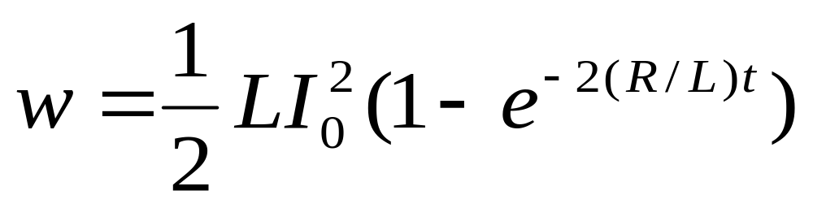
Continue
Energy absorb by the resistor is:

Slide 15
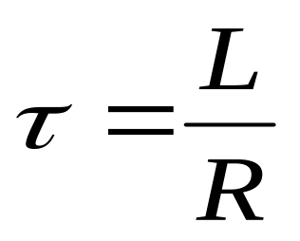
Time Constant, τ
Time constant, τ determines the rate at which the current or voltage approaches zero.
Time constant, (sec)

Slide 16
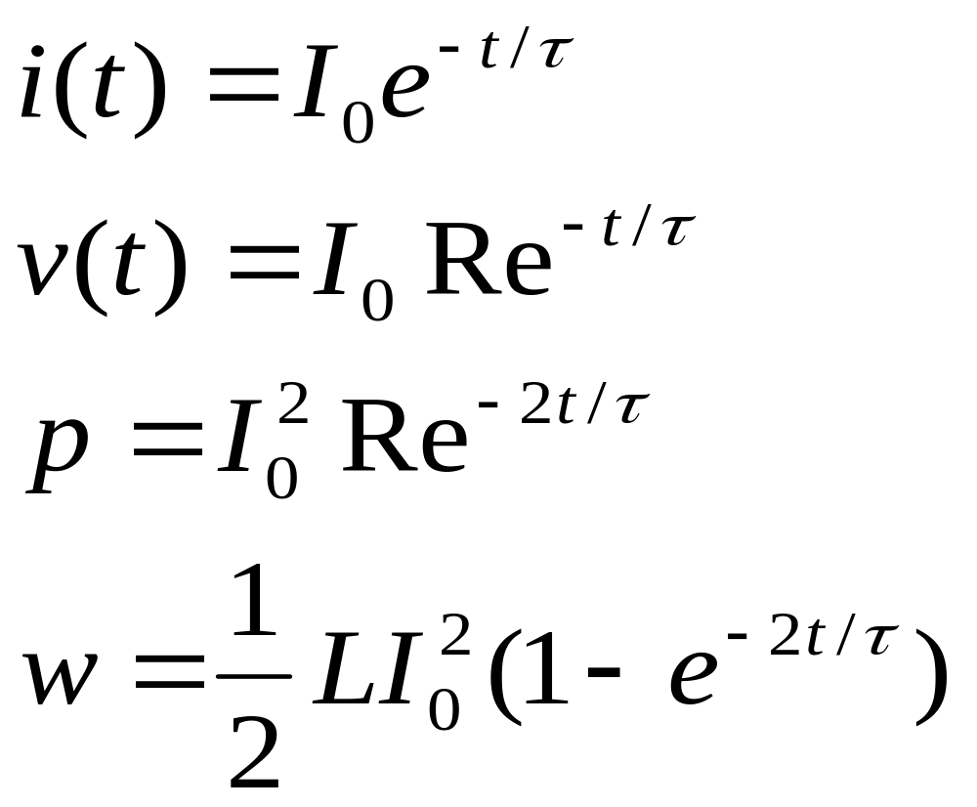
The expressions for current, voltage, power and energy using time constant concept:

Slide 17
Switching time
For all transient cases, the following instants of switching times are considered.
t = 0⁻ , this is the time of switching between -∞ to 0 or time before.
t = 0⁺ , this is the time of switching at the instant just after time t = 0s (taken as initial value)
t = ∞ , this is the time of switching between t = 0⁺ to ∞ (taken as final value for step response)

Slide 18
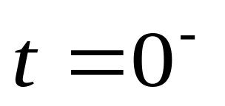
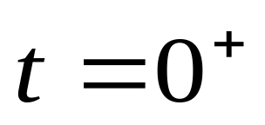
The illustration of the different instance of switching times is:
-∞
∞

Slide 19
Example
For the circuit below, find the expression of io(t) and Vo(t). The switch was closed for a long time, and at t = 0, the switch was opened.
2Ω
i0
t = 0
+
V
–
_{0.1Ω}
2H
_{10Ω}
20A
40Ω
iL

Slide 20
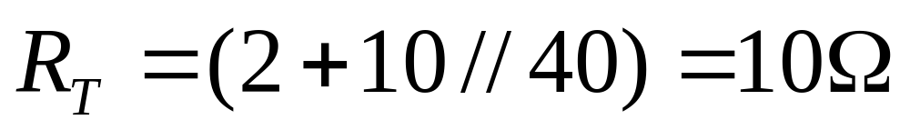
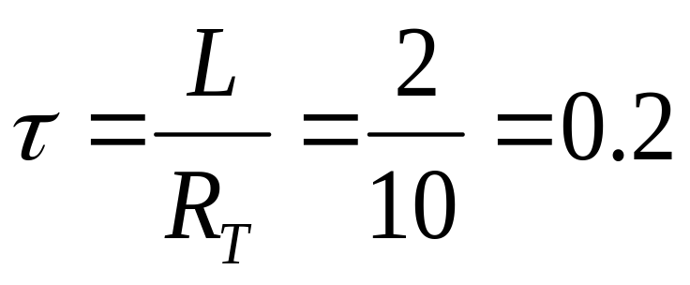
Solution :
Step 1:
Find τ for t > 0. Draw the equivalent circuit. The
switch is opened.
So;
sec

Slide 21
Step 2:
At t = 0⁻ , time from -∞ to 0^{-,} the switch was closed for
a long time.
The inductor behave like a short circuit as it being
supplied for a long time by a dc current source. Current
20A thus flows through the short circuit until the switch
is opened.
Therefore; i_{L}(0⁻) = 20A
2Ω
20A
_{0.1Ω}
_{10Ω}
40Ω
iL(0-)

Slide 22
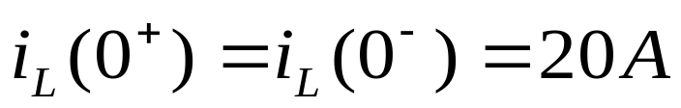
Step 3:
At the instant when the switch is opened, the time t = 0⁺,
The current through the inductor remains the same (continuous).
Thus, which is the initial current.
Only at this particular instant the value of the current through the
inductor is the same.
Since, there is no other supply in the circuit after the switch is
opened, this is the natural response case.
2Ω
i_{o}(0⁺)
+
v_{o}(0⁺)
–
20A
2H
_{10Ω}
40Ω
i_{L}(0⁺)

Slide 23
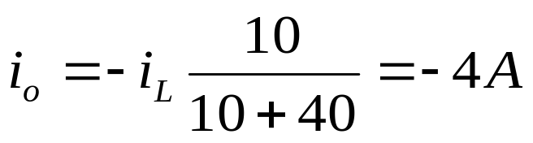
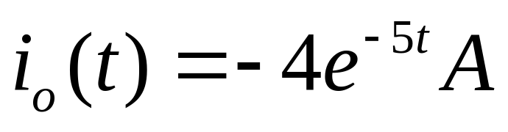
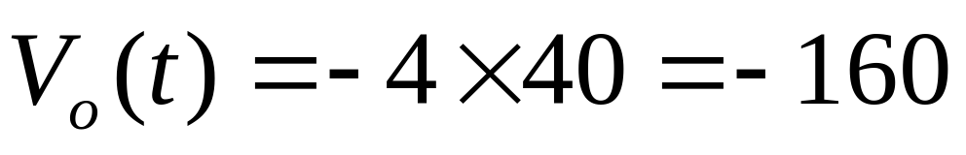
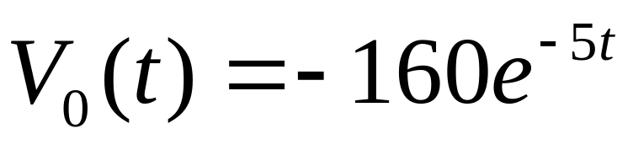
By using current division, the current in the 40Ω resistor
is:
So,
Using Ohm’s Law, the V_{o} is:
So,

Slide 24
NATURAL RESPONSE OF AN RC CIRCUIT
Consider the following circuit, for which the switch is closed for t < 0, and then opened at t = 0:
Notation:
0⁻ is used to denote the time just prior to switching
0⁺ is used to denote the time immediately after switching.
R_{o}
t = 0
+
−
+
v
–
V_{o}
R
C

Slide 25
Solving for the voltage (t ≥ 0)
For t ≤ 0, v(t) = V_{o}
For t > 0, the circuit reduces to
i
R_{o}
+
v
–
V_{o}
+
−
C
R

Slide 26
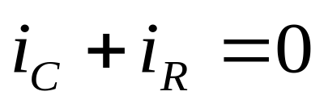
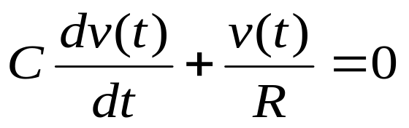
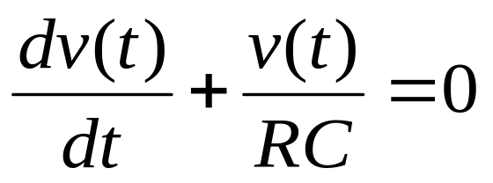
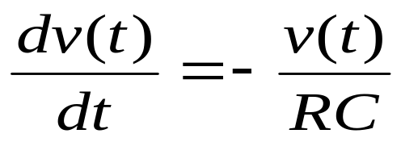
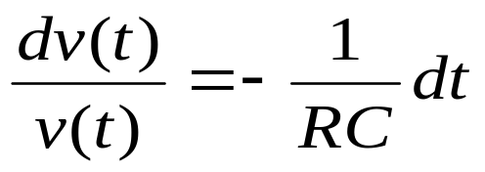
Continue
Applying KCL to the RC circuit:
(1)
(2)
(3)
(4)
(5)

Slide 27
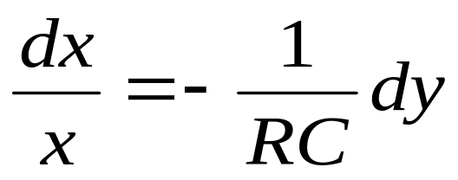
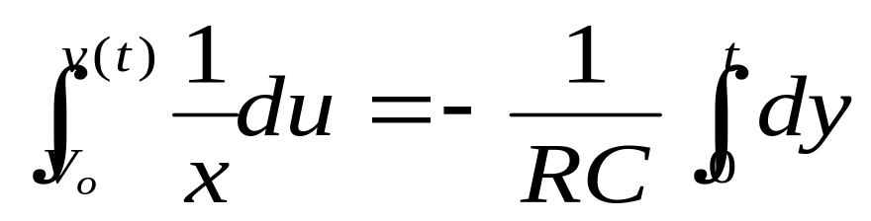
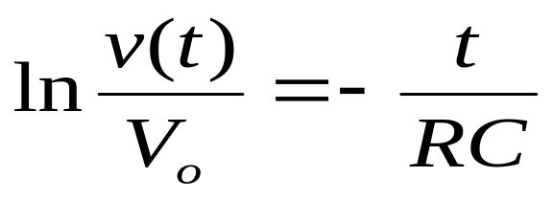
Continue
From equation (5), let say:
Integrate both sides of equation (6):
Therefore:
(6)
(7)
(8)

Slide 28
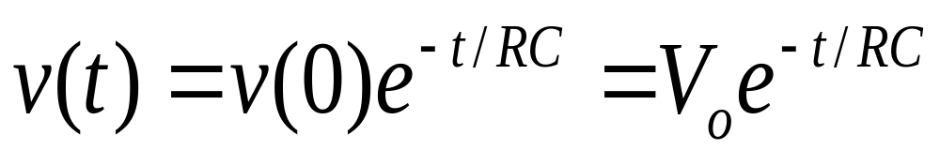
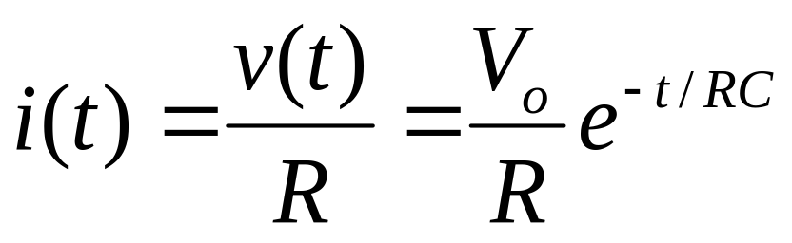
Continue
Hence, the voltage is:
Using Ohm’s law, the current is:

Slide 29
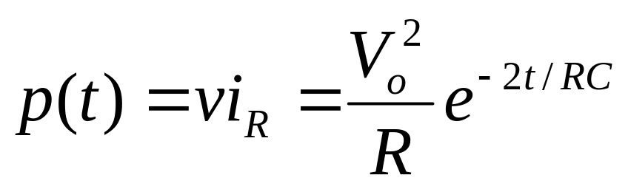
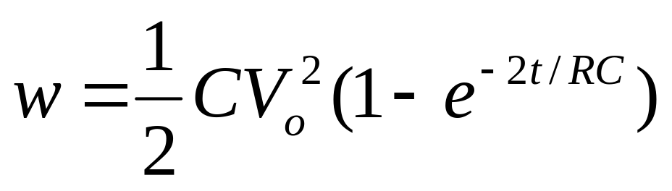
Continue
The power dissipated in the resistor is:
The energy absorb by the resistor is:

Slide 30
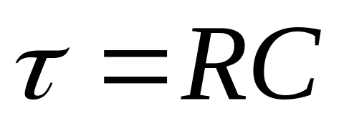
Continue
The time constant for the RC circuit equal the product of the resistance and capacitance,
Time constant, sec

Slide 31
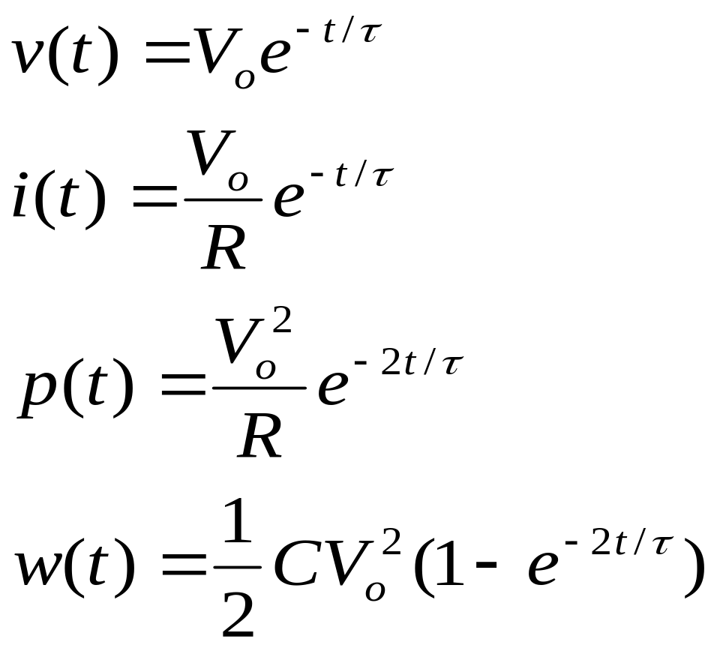
The expressions for voltage, current, power and energy using time constant concept:

Slide 32
For the case of capacitor, two important observation can be made,
1) capacitor behaves like an open circuit when being supplied by dc source
(From, i_{c} = Cdv/dt, when v is constant, dv/dt = 0. When current in circuit is zero, the circuit is open circuit.)
2) in capacitor, the voltage is continuous / stays the same that is, V_{c}(0⁺) = V_{c}(0⁻)

Slide 33
Example
The switch has been in position a for a long time. At
Time t = 0, the switch moves to b. Find the expressions
for the v_{c}(t), i_{c}(t) and v_{o}(t) and hence sketch them for t =
0 to t = 5τ.
5kΩ
a
b
18kΩ
t = 0
+
V_{o}
–
90V
+
−
10kΩ
60kΩ
12kΩ
0.1μF

Slide 34
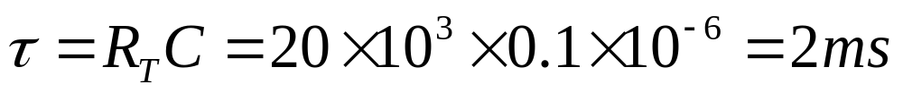
Solution
Step 1:
Find t for t > 5τ that is when the switch was at b. Draw
the equivalent circuit.
18kΩ
0.1μF
60kΩ
12kΩ

Slide 35
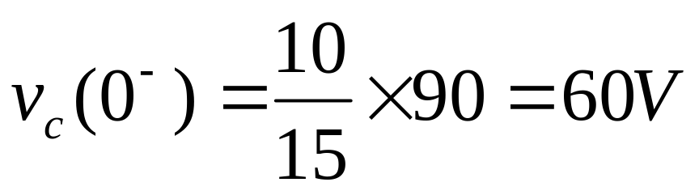
Step 2:
At t = 0, the switch was at a. the capacitor behaves like
An open circuit as it is being supplied by a constant
source.
5kΩ
+
V_{c}(0⁻)
–
90V
+
−
10kΩ

Slide 36
Step 3:
At t = 0⁺, the instant when the switch is at b.
The voltage across capacitor remains the same at this
particular instant.
v_{c}(0⁺) = v_{c}(0⁻) = 60V
18kΩ
+
60V
–
+
V_{o}
–
0.1μF
60kΩ
12kΩ

Slide 37
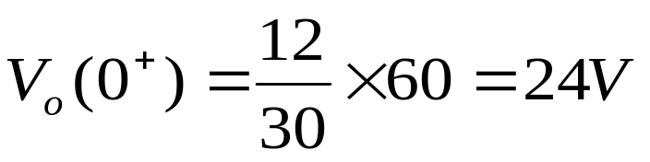
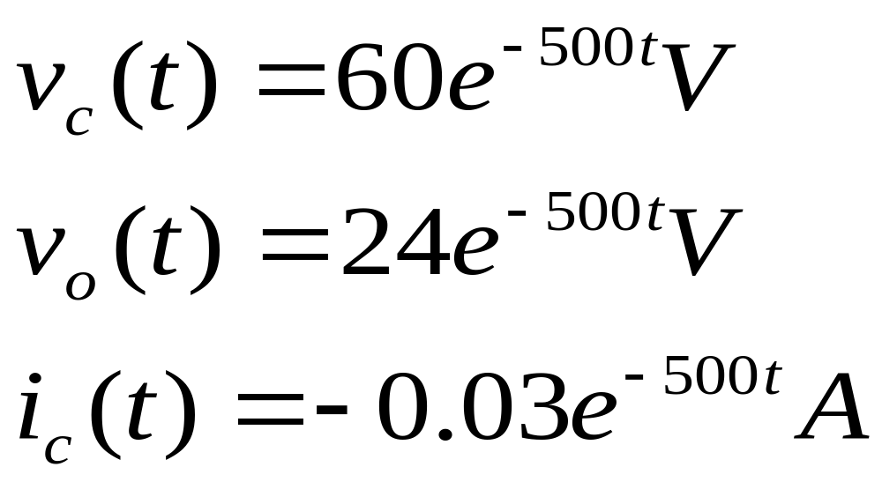
Using voltage divider rule,
Hence;

Slide 38
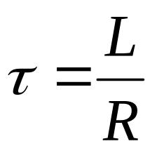
Summary
No | RL circuit | RC circuit
1
2 | Inductor behaves like a short circuit when being supplied by dc source for a long time | Capacitor behaves like an open circuit when being supplied by dc source for a long time
3 | Inductor current is continuous i_{L}(0⁺) = i_{L}(0⁻) | Voltage across capacitor is continuous v_{C}(0⁺) = v_{C}(0⁻)

Slide 39
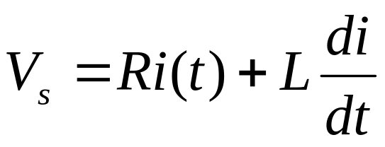
Step Response of RL Circuit
The switch is closed at time t = 0.
After switch is closed, using KVL
i
+
v(t)
–
t = 0
R
V_{s}
+
−
L
(1)

Slide 40
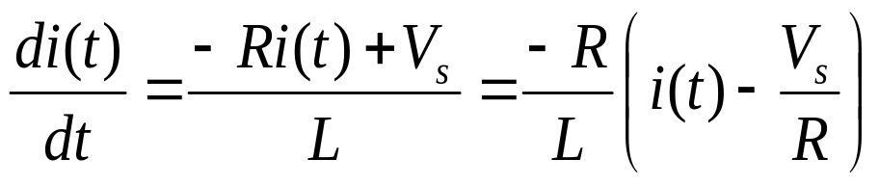
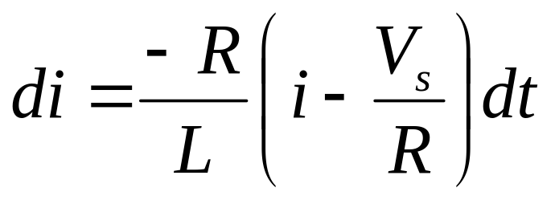
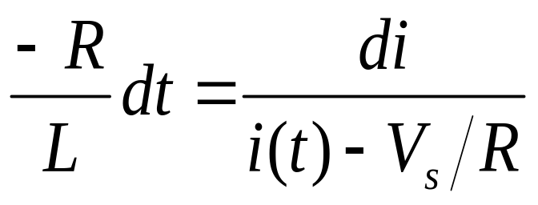
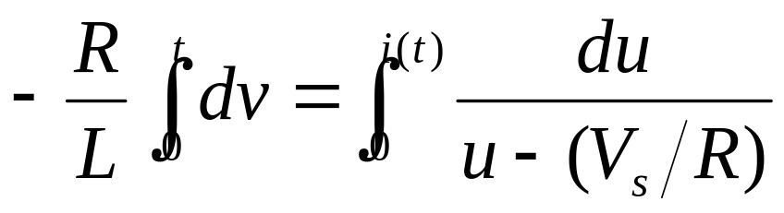
Continue
Rearrange the equation;
(2)
(3)
(4)
(5)

Slide 41
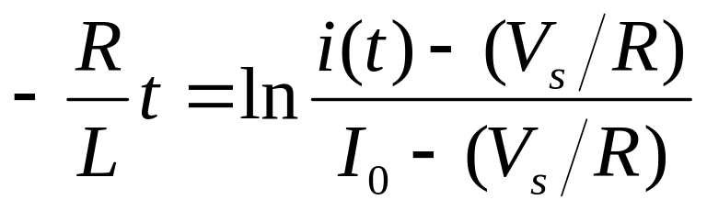
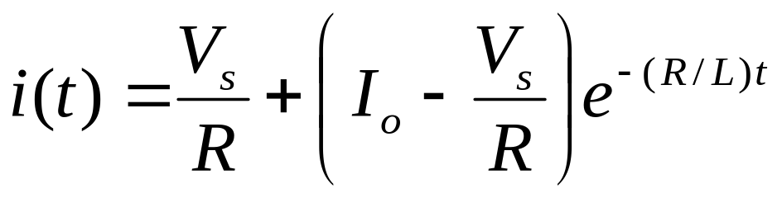
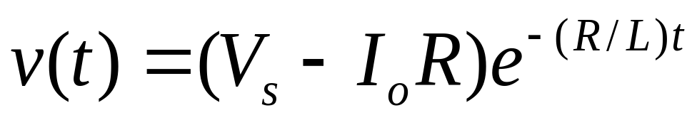
Continue
Therefore:
Hence, the current is;
The voltage;
(5)

Slide 42
Example
The switch is closed for a long time at t = 0, the switch
opens. Find the expressions for i_{L}(t) and v_{L}(t).
t = 0
2Ω
3Ω
10V
+
−
1/4H

Slide 43
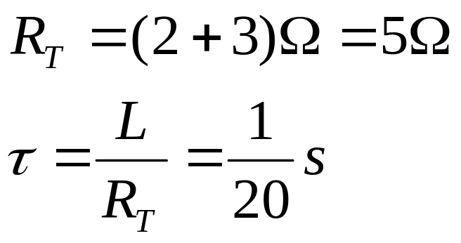
Solution
Step 1:
Find τ for t > 0. The switch was opened. Draw the
equivalent circuit. Short circuit the voltage source.
2Ω
3Ω
1/4H

Slide 44
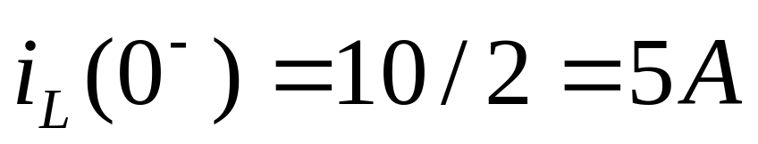
Continue
Step 2:
At t = 0⁻, the switch was closed. Draw the equivalent
circuit with 3Ω shorted and the inductor behaves like a
short circuit.
2Ω
10V
+
−
i_{L}(0-)

Slide 45
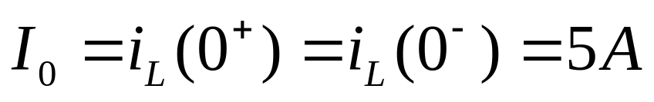
Continue
Step 3:
At t = 0⁺, the instant switch was opened. The current in
inductor is continuous.
Step 4:
At t =∞, that is after a long time the switch has been left
opened. The inductor will once again be behaving like a
short circuit.

Slide 46
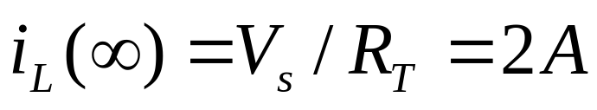


Continue
Hence:
2Ω
3Ω
10V
+
−
i_{L}(∞)

Slide 47


Continue
And the voltage is:

Slide 48

Step Response of RL Circuit
The switch is closed at time t = 0
From the circuit;
t = 0
+
v_{c}(t)
–
I_{s}
R
C
i
(1)

Slide 49



Continue
Division of Equation (1) by C gives;
Same mathematical techniques with RL, the voltage is:
And the current is:
(2)

Slide 50
Example
The switch has been in position a for a long time. At t = 0,
the switch moves to b. Find V_{c}(t) for t > 0 and calculate its
value at t = 1s and t = 4s.
3kΩ
a
b
4kΩ
t = 0
+
V_{c}
–
24V
+
−
5kΩ
+
−
30V
0.5mF

Slide 51

Solution
Step 1:
To find τ for t > 0, the switch is at b and short circuit the
voltage source.
4kΩ
0.5mF

Slide 52

Continue
Step 2:
The capacitor behaves like an open circuit as it is being
supplied by a constant dc source.
From the circuit,
3kΩ
+
V_{c} (0-)
–
24V
+
−
5kΩ

Slide 53


Continue
Step 3:
At t = 0⁺, the instant when the switch is just moves to b.
Voltage across capacitor remains the same.
Step 4:
At t = ∞, the capacitor again behaves like an open circuit since it is being supplied by a constant source.
4kΩ
+
V_{c}(∞)
–
+
−
30V

Slide 54

Continue
Step 5:
Hence,
At t = 1s, V_{c}(t) = 20.9V
At t = 4s, V_{c}(t) = 28 V

Slide 55
THE END

